Slide 1
Adding Image, audio and video files to web pages

Slide 2
Summary of the previous lecture
Internal links
External links
Directory Structure
Internal document reference
Some attributes of <a>

Slide 3
Outline
Adding images to web pages
Using images as links
Image map
Adding video to web pages
Adding audio to web pages

Slide 4
1. Adding images to web pages
<img> tag is used to add images to web pages
SRC attribute of the <img> tag is used to indicate the source of the image
We can add an image by
<img src=“image-name”>
<img src=“abc.jpg”>

Slide 5
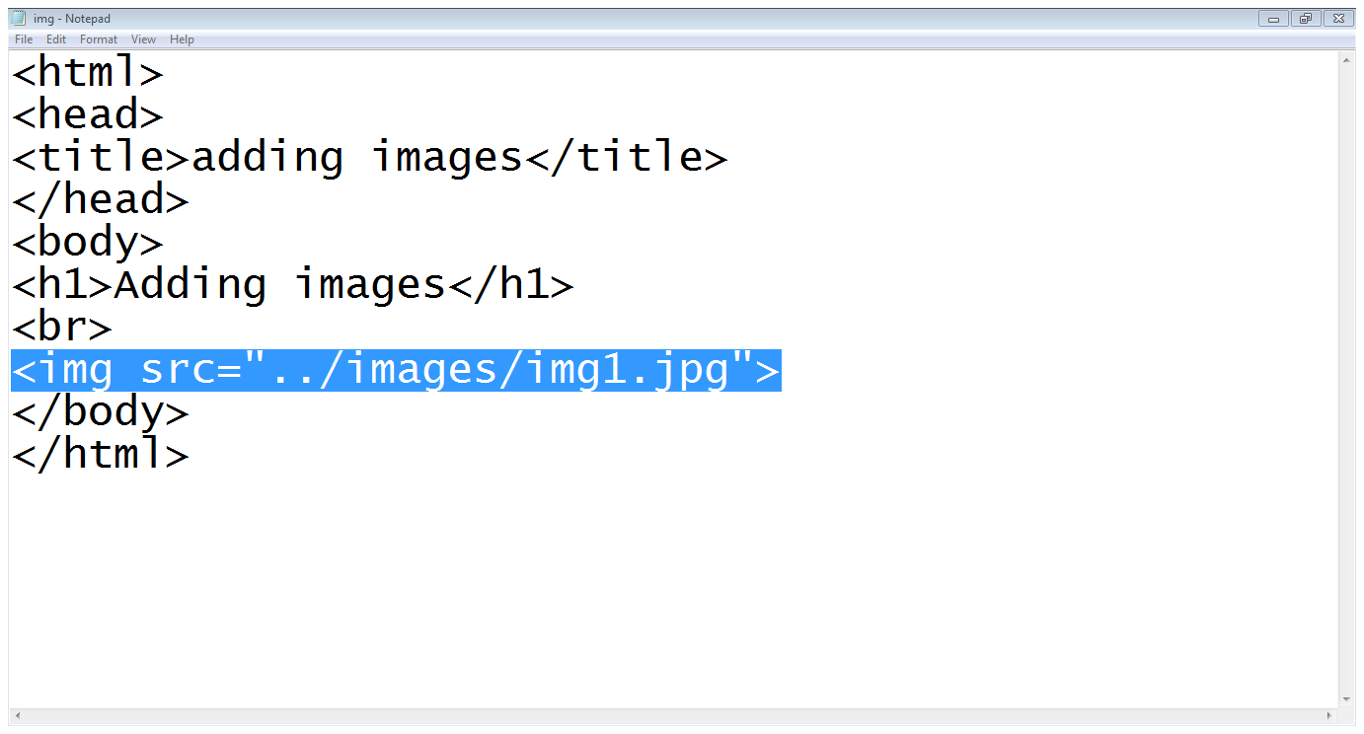
1. Adding images to web pages...
Image path and name
Root Directory
examples
images
ex.html
img1.jpg
Image tag
Src attribute

Slide 6
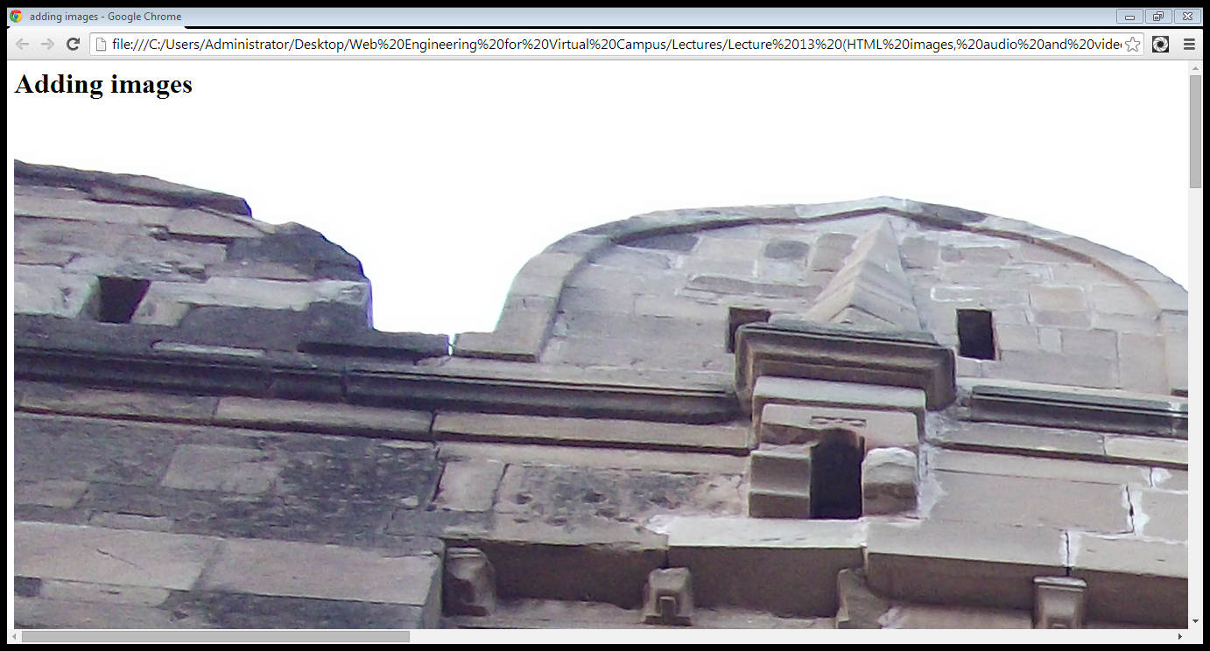
1. Adding images to web pages...

Slide 7
1.1 Attributes of <img> tag
Height and width:
<img src=“image-name” height=“100” width=“100”>
Alt attribute:
<img src=“image-name” alt=“image description”>
Align attribute:
<img src=“image-name” align=“left”>
Left, right, top, bottom, middle

Slide 8
1.1 Attributes of <img> tag …
4. Border attribute:
<img src=“image-name” border=“2”>

Slide 9
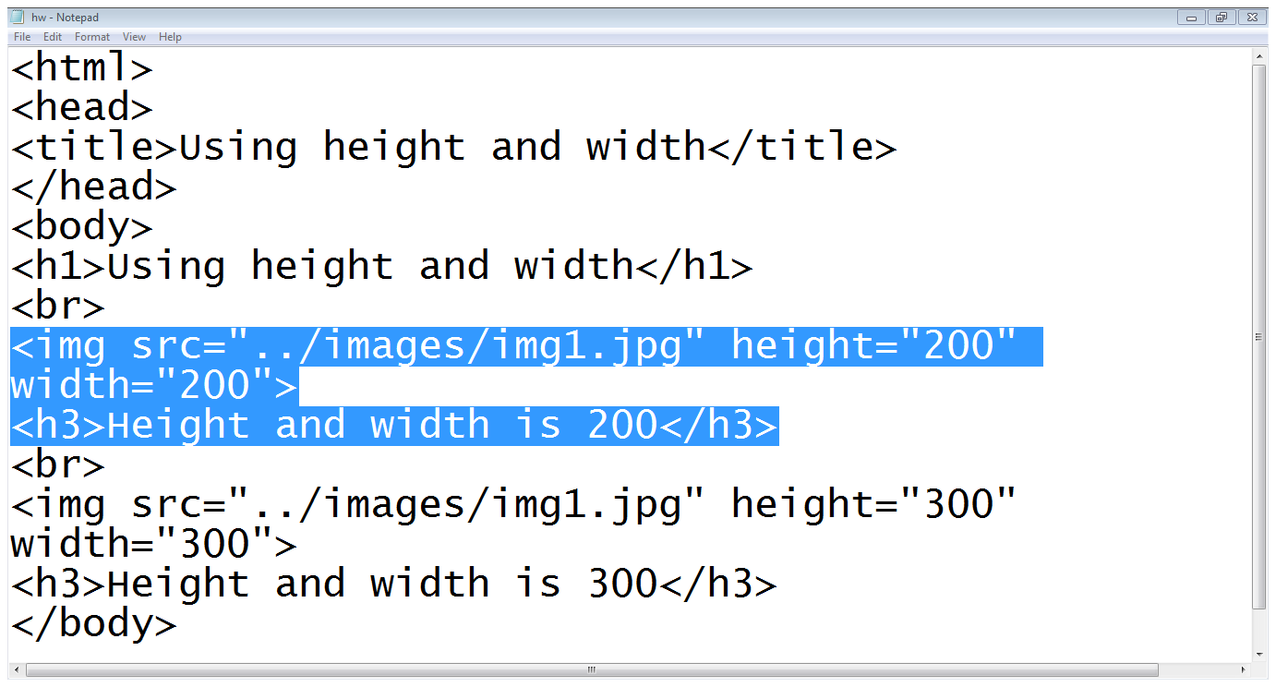
1.1 Attributes of <img> tag …

Slide 10
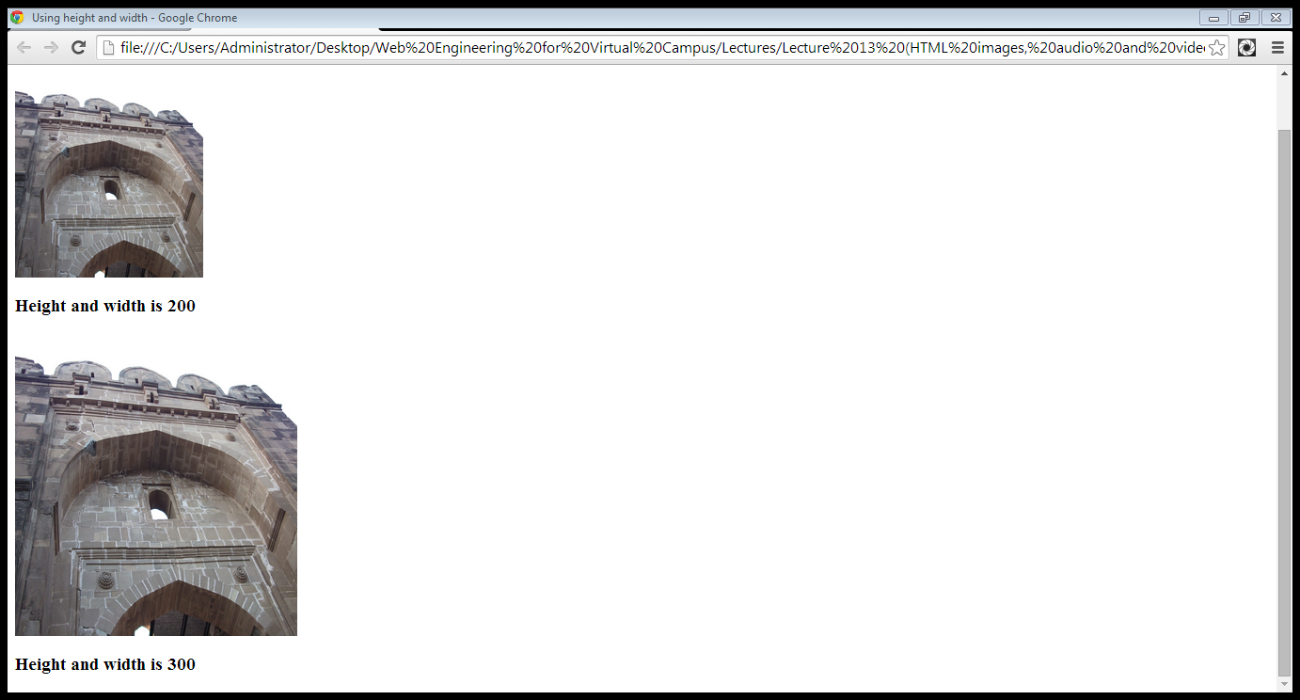
1.1 Attributes of <img> tag …

Slide 11
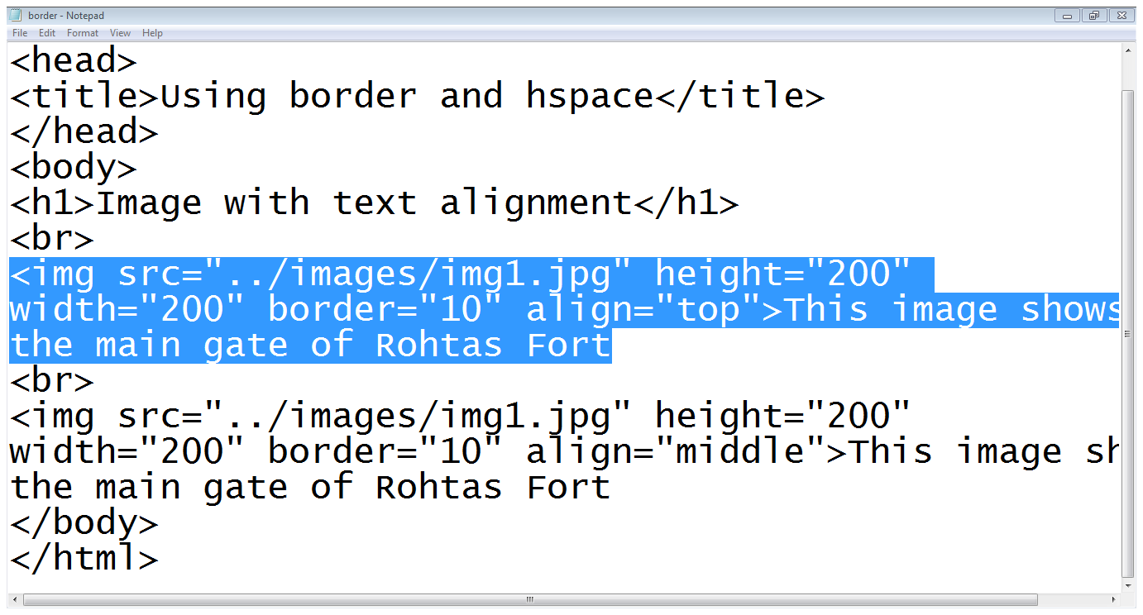
1.1 Attributes of <img> tag …

Slide 12
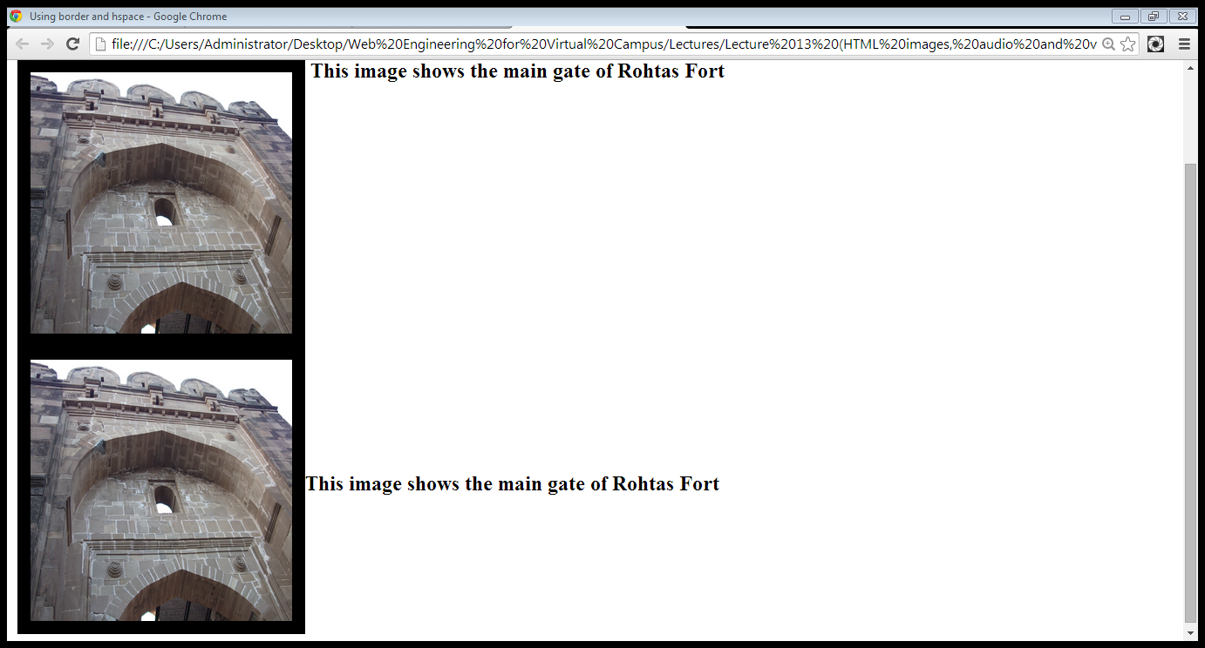
1.1 Attributes of <img> tag …
Align top
Align middle

Slide 13
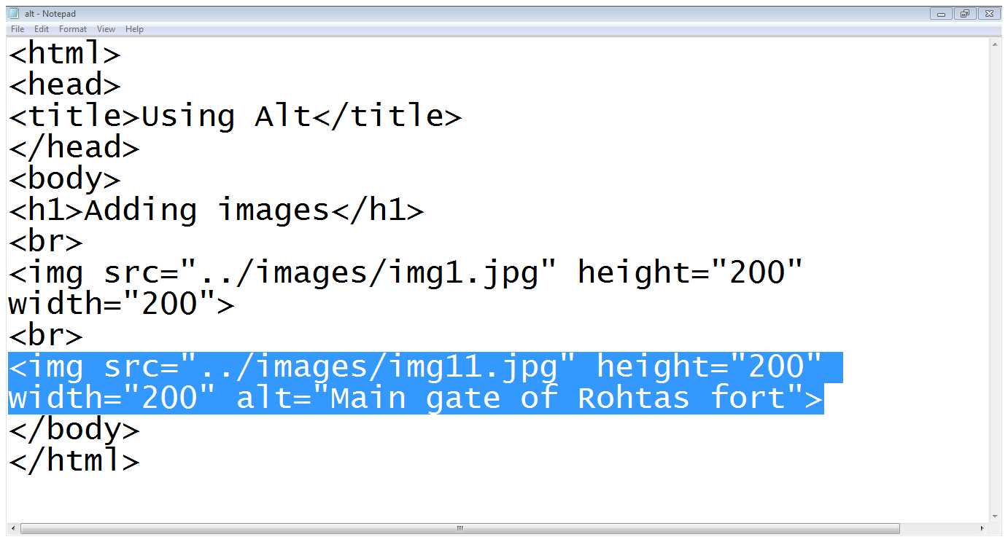
1.1 Attributes of <img> tag …
Wrong image name

Slide 14
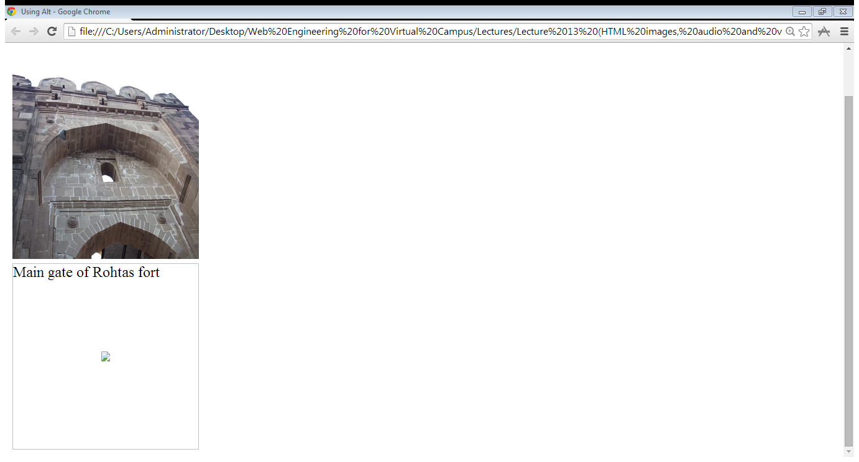
1.1 Attributes of <img> tag …
Image is found
Image not found

Slide 15
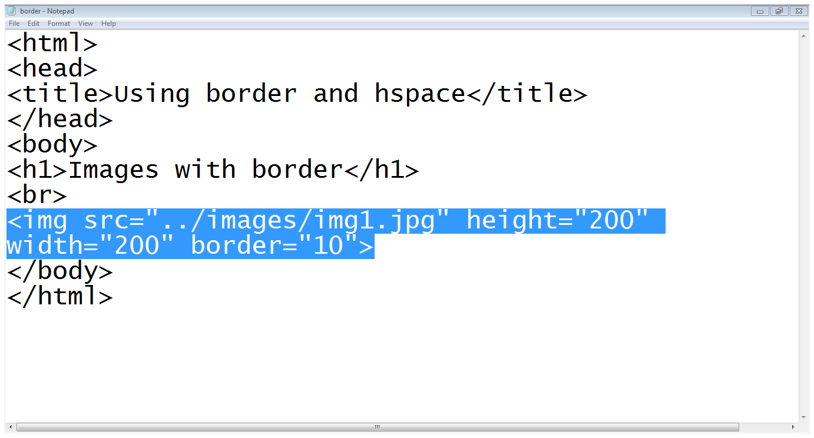
1.1 Attributes of <img> tag …

Slide 16
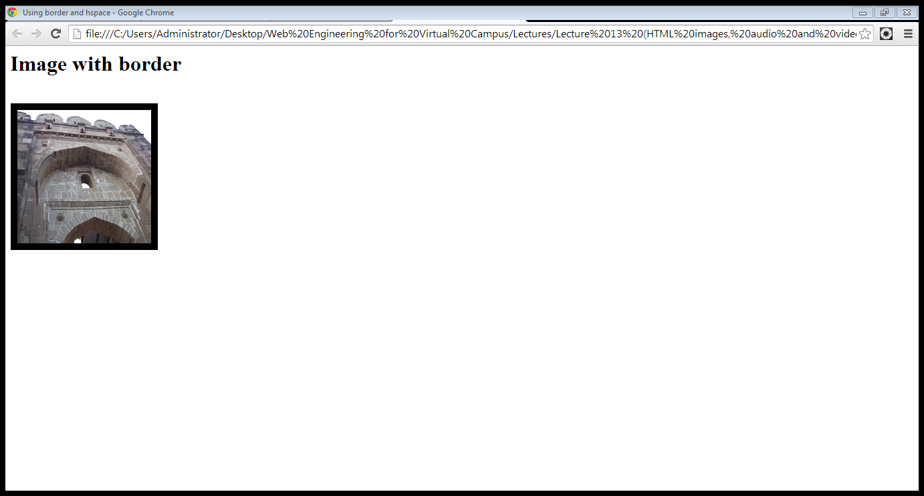
1.1 Attributes of <img> tag …

Slide 17
2. Using images for linking
We can put images between <a> and </a > tags instead of text to link other documents or portions of the page
<a href=“page-reference”> <img src=“image-srource”></a>
<a href=“abc.html”> <img src=“img.jpg”></a>

Slide 18
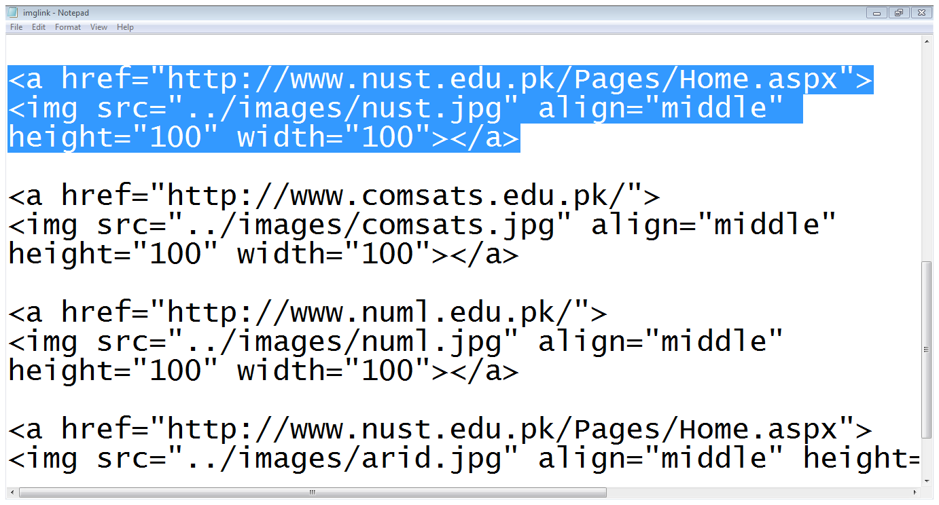
2. Using images for linking…
Link
Image

Slide 19
3. Image maps
Image maps allow you to add multiple links to the same image
Each link can point to a different page
Each of these clickable areas is known as a hotspot

Slide 20
3. Image maps…
Defining a map:
Step1 (Define a map):
<map name=“map name”>
<area shape=“link-shape” coords=“coordinates of link area” href=“page-reference”>
</map>
Step2(using the map):
<img src=“image-title” usermap=“#map-name”>

Slide 21
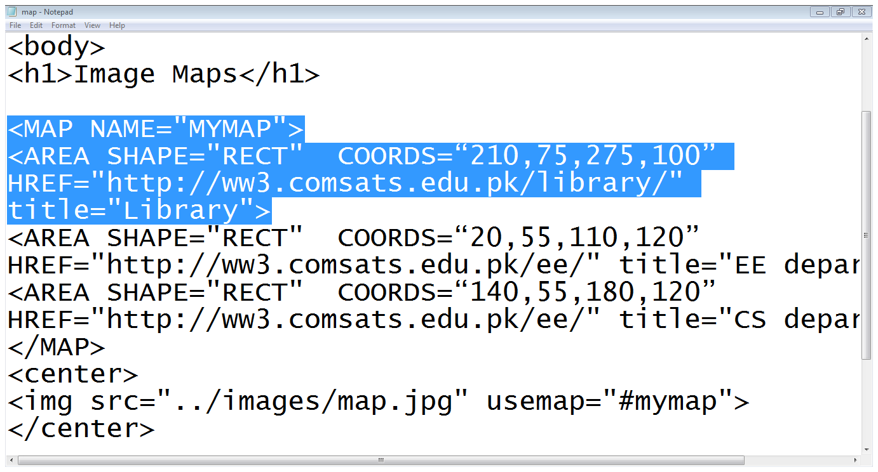
3. Image maps…
Map name
Shape
Coordinates
Map
Area tag
Link
End of Map
Using a map
Adding an Image

Slide 22
4. Adding videos to web pages
The <video> tag is used to add a video to a web page
This tag is provided in HTML5
The src attribute of the <video> tag is used to indicate the source of the video
We can add a video to our page as
<video src=“abc.mp4”>

Slide 23
4. Adding videos to web pages…
Attributes of <video> tag:
Auto-play
Controls
Height
Loop

Slide 24
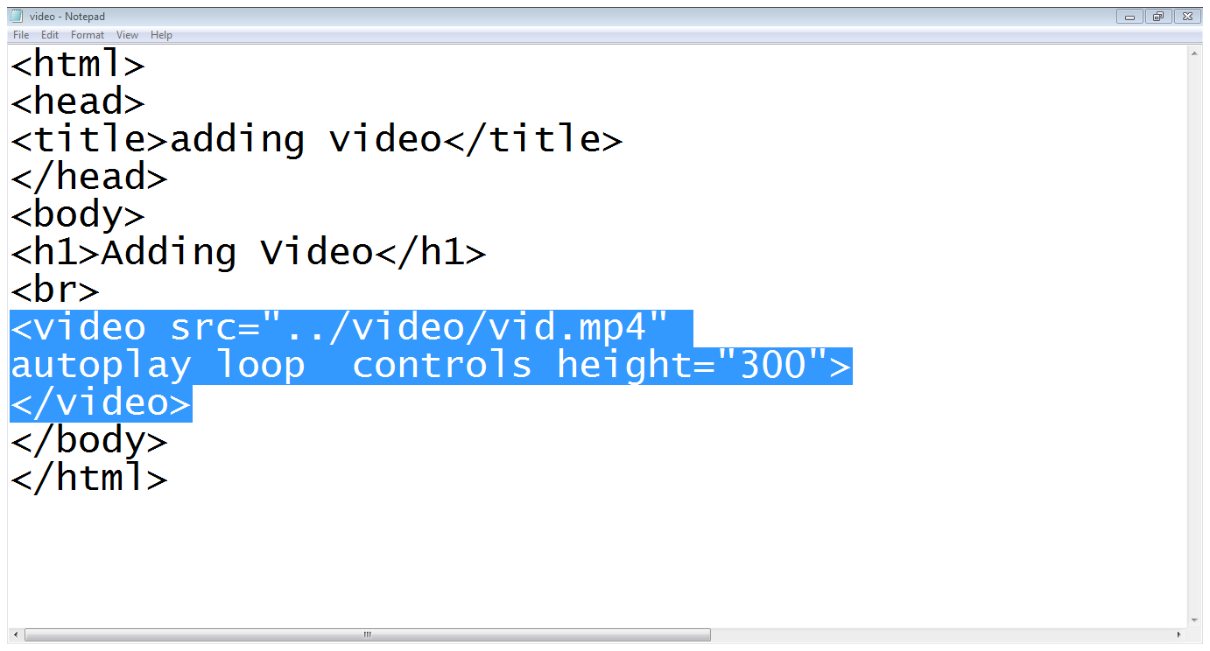
4. Adding videos to web pages…
Video tag
Source of the video
Controls attribute
Loop attribute
Auto-play attribute

Slide 25
5. Adding audio to web pages…
The <audio> tab is used to add a video to a web page
This tag is provided in HTML5
The src attribute of the <audio> tag is used to indicate the source of the audio
We can add a video to our page as
<audio src=“abc.mp3”>

Slide 26
5. Adding audio to web pages…
Attributes of <audio> tag:
Auto-play
Controls
Loop

Slide 27
Summary
Adding images to web page
Using images as links
Image map
Adding audio and video to web page

Slide 28
References
Chapter 3, Beginning HTML, XHTML,CSS, and JavaScript, by Jon Duckett, Wiley Publishing; 2009, ISBN: 978-0-470-54070-1.

